Slide 1
TCP
CS 168 – Fall 2017 – Section 9

Slide 2
Agenda
Transmission Control Protocol (TCP)

Slide 3
TCP
L4 Protocol (Transport)
Byte Stream
Bi-directional
Reliable
In-order
Source port
Destination port
Sequence number
Acknowledgment
HdrLen
0
Flags
Advertised window
Checksum
Urgent pointer
Options (variable)
Data
Notes:
UDP is message-oriented
Message Oriented protocols send data in distinct chunks or groups. Stream protocols send a continuous flow of data.

Slide 4
TCP Header
Host port numbers
Multiplexing and demultiplexing
16 bits
Source port
Destination port
Sequence number
Acknowledgment
HdrLen
0
Flags
Advertised window
Checksum
Urgent pointer
Options (variable)
Data

Slide 5
TCP Header
Byte offset
Of first payload byte
Initialized randomly
Byte Stream Protocol
Seq # refers to bytes
Source port
Destination port
Sequence number
Acknowledgment
HdrLen
0
Flags
Advertised window
Checksum
Urgent pointer
Options (variable)
Data
Notes:
If the SYN flag is set (1), then this is the initial sequence number. The sequence number of the actual first data byte and the acknowledged number in the corresponding ACK are then this sequence number plus 1.
If the SYN flag is clear (0), then this is the accumulated sequence number of the first data byte of this segment for the current session.
Bytes rather than packets

Slide 6
TCP Header
Cumulative ACKs
Seq # of next byte
Data packets carry ACKs
Source port
Destination port
Sequence number
Acknowledgment
HdrLen
0
Flags
Advertised window
Checksum
Urgent pointer
Options (variable)
Data

Slide 7
TCP Header
Header length
4 bits
In 4-byte words
Minimum 5 words (20 B)
Maximum 15 words
Why?
Source port
Destination port
Sequence number
Acknowledgment
HdrLen
0
Flags
Advertised window
Checksum
Urgent pointer
Options (variable)
Data
Notes:
Only 4 bits, so max is 2^4 – 1 = 15 words

Slide 8
TCP Header
SYN
SYNchronize initial state
ACK
ACKnowledgement
FIN
No more data
RST
Connection ReSeT
Source port
Destination port
Sequence number
Acknowledgment
HdrLen
0
Flags
Advertised window
Checksum
Urgent pointer
Options (variable)
Data
Notes:
9 bits
FIN says "i finished talking to you, but i'll still listen to everything you have to say until you're done"
RST says "there is no conversation. i won't say anything and i won't listen to anything you say
If the SYN flag is set (1), then this is the initial sequence number. The sequence number of the actual first data byte and the acknowledged number in the corresponding ACK are then this sequence number plus 1.
If the SYN flag is clear (0), then this is the accumulated sequence number of the first data byte of this segment for the current session.

Slide 9
TCP Header
Receive Window Size
Maximum receiver buffer
Limits sending rate
Don’t send faster than receiver can process
Source port
Destination port
Sequence number
Acknowledgment
HdrLen
0
Flags
Advertised window
Checksum
Urgent pointer
Options (variable)
Data
Notes:
unit: byte
limited to between 2 and 65,535 bytes.

Slide 10
TCP Header
Checksum
Includes header and payload
Options common
Unlike IP
Not covered
Assume no options unless specified
Source port
Destination port
Sequence number
Acknowledgment
HdrLen
0
Flags
Advertised window
Checksum
Urgent pointer
Options (variable)
Data

Slide 11
Connection Establishment

Slide 12
Connection Establishment
Sequence number and acknowledgement number don’t start from zero
Instead client and server choose a random initial seq #
Why?
Must be communicated between client and server
Notes:
Connection spoofing, connection resetting, and data injection

Slide 13
Connection Establishment
Client/Server exchange state
Initial Sequence numbers
Port number
TCP Options
Notes:
example about TCP options:
- Maximum Segment Size (MSS)
- Selective Acknowledgements (SACK)

Slide 14
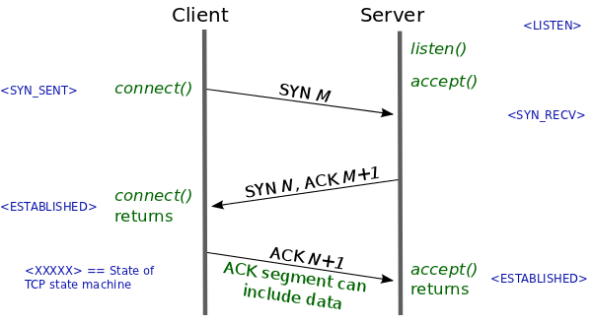
Three Way Handshake
Client sends server a SYN
A TCP packet with the SYN flag set
SYN packet carries initial state
Receive window
Source port number
Initial sequence number

Slide 15
Three Way Handshake
Server responds with a SYN-ACK
Acknowledge the client’s SYN
Respond with the server’s own SYN
Carries server’s initial state
Receive window
Source port number
Initial sequence number

Slide 16
Three Way Handshake
Client responds with an ACK
Now the connection is established!
Client and server can freely communicate

Slide 17
Teardown

Slide 18
Two Teardown Methods
Four way handshake
Graceful/normal teardown
Reset
Exceptional Teardown

Slide 19
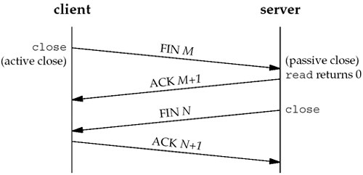
Normal Teardown
One side closes their connection
Indicates they will send no more data
Sends a FIN
Receives an ACK
Other side may continue transmitting
Eventually it closes as well
Sends a FIN
Receives an ACK
Connection is closed
Notes:
could combine into three-way handshake

Slide 20
TCP Reset
Reset the connection
Most commonly, attempt to SYN on a closed port
Send RST packet(s) only (no ACK)
Notes:
If side that sent RST receives more packets, will resend the RST

Slide 21
Reliability

Slide 22
Reliability
Cumulative ACKs
Allow detection of dropped packets
How do we know a packet was lost?
Timeout
Duplicate ACKs

Slide 23
Timeout
Retransmission Time Out (RTO)
Timeout after which packets are retransmitted
Based on a constantly updated RTT estimate (and variance)
Single timer (not per-packet)
Each received ACK resets RTO
If RTO times out
Retransmit packet containing “next byte”
Notes:
exponential weighted moving average

Slide 24
Timeout
What if RTO is too large?
Packet is dropped . . .
Wait
Keep waiting
… Keep waiting
Timer goes off
Finally retransmit
Can we do better?

Slide 25
Duplicate ACKs
Transmit
Seq 1000
Seq 2000
Seq 3000 Dropped in flight
Seq 4000
Seq 5000
Seq 6000
What ACKs do we receive?
ACK 2000
ACK 3000
ACK 3000
ACK 3000
ACK 3000
Duplicate ACKs indicate packet loss/reorder

